Slide 1
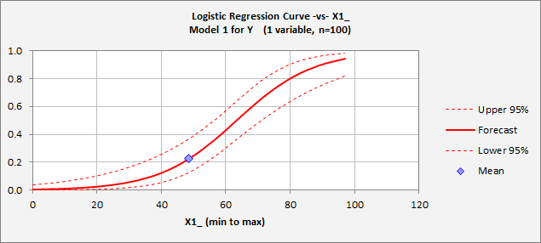
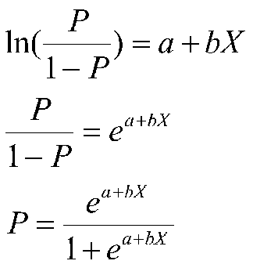
Mathematical Model
The model used is Logistic Regression
Logistic regression predicts a dependent data variable by analyzing the relationship between one or more existing independent variables.
Resulting analytical model can take into consideration multiple input criteria.
Equation Used
Equation Graph

Slide 2
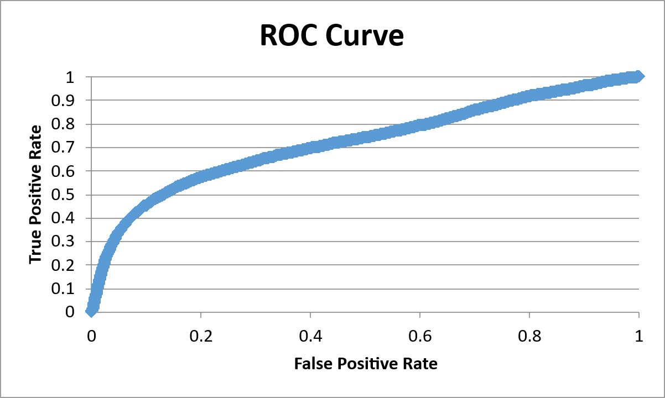
Historical Data Analysis
Significance Level of Variables used in Modelling
ROC curve showing model performance at all classification thresholds
Model depicts 95% Confidence level
Red code depicts insignificant variables for prediction
Green Code depicts significant variables

Slide 3
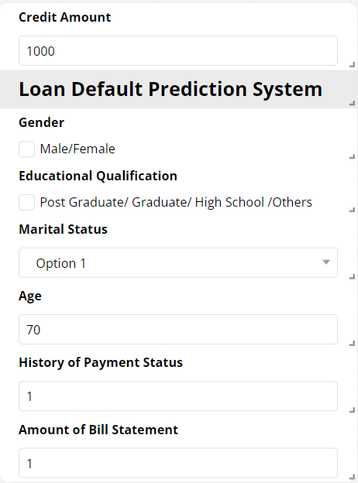
Final Prediction
Screenshot of the app’s Interface
We used a line equation of the form y=m(x)+c where x is independent variable
C is intercept when X = 0, the intercept is the log of the odds of having the outcome
And m is slope calculated by Logistic Regression

Slide 4
Annexures

Slide 5
Annexures
Covariance Matrix
0.023505 | -0.00031 | -0.00049 | -0.00048 | -0.00032 | -4.9E-09 | -0.00281 | -0.00116 | -0.00388 | -0.00021 | -0.00015 | -9.1E-05 | -5.5E-05 | 1.87E-06 | -3.2E-05 | 8.44E-05 | -2.5E-09 | 1.09E-09 | 9.04E-10 | -5E-10 | 1.55E-10 | 1.47E-09 | -1.6E-08 | -6.3E-09 | -1.2E-09 | -3.2E-09 | 2.4E-09 | -1.1E-09
-0.00031 | 0.000165 | 1.01E-06 | 8.66E-07 | -6.5E-07 | -1.7E-11 | -2.5E-06 | -8.8E-07 | -1.1E-06 | -2.6E-07 | 2.42E-06 | -3.6E-06 | 2.15E-06 | -8.9E-08 | -1.6E-06 | 7.44E-07 | 5.83E-11 | -3.5E-11 | -7.8E-12 | -6.3E-13 | -6.7E-11 | 2.05E-11 | 2.68E-10 | 5.16E-11 | 2.3E-10 | -6E-11 | -9.1E-11 | 1.04E-11
-0.00049 | 1.01E-06 | 0.000493 | -4.4E-06 | 7.95E-07 | -6E-12 | 4.34E-06 | 4.72E-06 | -5.3E-06 | -5.4E-07 | 3.8E-06 | 2.09E-07 | -6.3E-06 | 2.81E-06 | 6.31E-06 | -6.8E-06 | -2.4E-11 | -9.9E-11 | 1.62E-10 | -9.5E-11 | 3.34E-10 | -3E-10 | 3.74E-10 | 3.26E-10 | -3.6E-10 | 6.82E-10 | 3.75E-10 | -2.5E-10
-0.00048 | 8.66E-07 | -4.4E-06 | 0.000499 | -2.3E-06 | 4.75E-11 | 5.45E-06 | -3.2E-07 | -2.1E-06 | -8.2E-07 | 1.17E-07 | 8.47E-07 | -8E-06 | 1.74E-05 | -9E-06 | 3.8E-06 | -2.3E-11 | 2.21E-12 | 2.57E-10 | 2.05E-10 | -9.1E-10 | 4.11E-10 | -7.9E-11 | 3.89E-10 | -4.5E-11 | 1.35E-10 | -2.9E-10 | -2.5E-11
-0.00032 | -6.5E-07 | 7.95E-07 | -2.3E-06 | 0.000165 | 1.72E-11 | -4E-06 | -1.8E-06 | 5.27E-07 | 1.16E-07 | -1.2E-06 | 1.87E-06 | 3.13E-06 | -5.4E-06 | -9.3E-07 | 5.95E-07 | 8.93E-11 | -2E-10 | 3.93E-11 | 2.09E-10 | -3.5E-10 | 2.41E-10 | 4.92E-10 | 9.07E-11 | -9.8E-11 | -6E-11 | -2.2E-10 | -2.3E-10
-4.9E-09 | -1.7E-11 | -6E-12 | 4.75E-11 | 1.72E-11 | 3.65E-14 | -2.5E-10 | 1.23E-09 | 6.35E-10 | -4.7E-11 | 7.94E-11 | 4.89E-10 | 1.7E-10 | 1.98E-10 | 8.66E-11 | 3.62E-10 | -1.7E-14 | 8.29E-15 | 7.37E-15 | -1.1E-14 | -4.9E-15 | -5E-15 | -4.2E-14 | -3.1E-14 | -2.2E-14 | -2.9E-14 | -2.7E-14 | -3.2E-14
-0.00281 | -2.5E-06 | 4.34E-06 | 5.45E-06 | -4E-06 | -2.5E-10 | 0.001412 | -4.6E-05 | 0.000134 | 1.28E-05 | -4.8E-07 | 1.15E-05 | 1.49E-05 | 4.56E-06 | 1.95E-05 | -1.8E-05 | 3.89E-10 | 1.02E-09 | -2.8E-10 | -1.3E-09 | 3.4E-10 | -3.6E-10 | 1.36E-10 | 1.58E-09 | 7.26E-10 | -3.8E-13 | 3.12E-10 | 6.61E-10
-0.00116 | -8.8E-07 | 4.72E-06 | -3.2E-07 | -1.8E-06 | 1.23E-09 | -4.6E-05 | 0.000685 | 0.000104 | -9.7E-06 | -1E-05 | -1.5E-05 | -5.6E-06 | -7.8E-06 | -6.8E-06 | 1.08E-05 | -1.1E-09 | 1.64E-10 | 1.13E-11 | 4.86E-11 | 1.35E-09 | -6.9E-10 | -2.5E-11 | -6.8E-10 | -4.3E-10 | -7.8E-10 | 4.26E-10 | -6E-11
-0.00388 | -1.1E-06 | -5.3E-06 | -2.1E-06 | 5.27E-07 | 6.35E-10 | 0.000134 | 0.000104 | 0.001471 | 3.21E-05 | 6.63E-07 | 1.95E-05 | -7.9E-06 | 3.63E-06 | -3.3E-06 | -6.7E-06 | -9.5E-11 | -2.1E-10 | -1.4E-10 | 8.68E-10 | -3E-10 | -1.4E-10 | -2.2E-10 | -6.8E-10 | -8.7E-10 | -3.5E-12 | -1.7E-09 | -2.5E-10
-0.00021 | -2.6E-07 | -5.4E-07 | -8.2E-07 | 1.16E-07 | -4.7E-11 | 1.28E-05 | -9.7E-06 | 3.21E-05 | 4.75E-06 | 6.18E-08 | 1.07E-06 | 2.68E-07 | -1.4E-07 | 9.56E-07 | -6.1E-07 | 1.38E-11 | -1.5E-11 | -3.4E-11 | 3.43E-11 | -3.3E-12 | -8.2E-12 | 8.16E-11 | 1.56E-11 | -3.6E-11 | 4.14E-11 | 4.96E-13 | 4.53E-11
-0.00015 | 2.42E-06 | 3.8E-06 | 1.17E-07 | -1.2E-06 | 7.94E-11 | -4.8E-07 | -1E-05 | 6.63E-07 | 6.18E-08 | 0.000453 | -0.00018 | 6.46E-06 | -3.1E-05 | 1.35E-06 | -2E-05 | 1.37E-09 | -1.3E-09 | -1E-10 | 2.8E-10 | -1E-09 | 1.26E-10 | 4.53E-09 | 2.19E-09 | 1.22E-09 | 1.82E-09 | 1.62E-10 | 5.77E-10
-9.1E-05 | -3.6E-06 | 2.09E-07 | 8.47E-07 | 1.87E-06 | 4.89E-10 | 1.15E-05 | -1.5E-05 | 1.95E-05 | 1.07E-06 | -0.00018 | 0.00059 | -0.00031 | 3.73E-06 | -5.3E-05 | -1.5E-05 | -2.6E-09 | 8.07E-10 | 2.97E-10 | 5.48E-11 | 4.38E-10 | -4.2E-11 | 8.75E-09 | -1.7E-09 | -1.8E-10 | -8.8E-10 | -6.1E-10 | -1E-09
-5.5E-05 | 2.15E-06 | -6.3E-06 | -8E-06 | 3.13E-06 | 1.7E-10 | 1.49E-05 | -5.6E-06 | -7.9E-06 | 2.68E-07 | 6.46E-06 | -0.00031 | 0.000741 | -0.00036 | 1.77E-05 | -5E-05 | 2.19E-09 | -2.3E-09 | -3E-10 | 1.27E-10 | -4E-10 | 6.91E-10 | -8.2E-09 | 7.94E-09 | -1.1E-09 | 5.99E-10 | -4.8E-10 | 4.38E-10
1.87E-06 | -8.9E-08 | 2.81E-06 | 1.74E-05 | -5.4E-06 | 1.98E-10 | 4.56E-06 | -7.8E-06 | 3.63E-06 | -1.4E-07 | -3.1E-05 | 3.73E-06 | -0.00036 | 0.000955 | -0.00048 | -4.8E-05 | 7.07E-10 | 6.93E-10 | -1.8E-09 | -1.9E-09 | 2.89E-09 | -8.1E-10 | 4.25E-10 | -6E-09 | 8.75E-09 | -3.3E-09 | 2.74E-10 | -4.8E-10
-3.2E-05 | -1.6E-06 | 6.31E-06 | -9E-06 | -9.3E-07 | 8.66E-11 | 1.95E-05 | -6.8E-06 | -3.3E-06 | 9.56E-07 | 1.35E-06 | -5.3E-05 | 1.77E-05 | -0.00048 | 0.001041 | -0.00046 | 3E-10 | 3.39E-10 | 1.16E-09 | -1.9E-09 | -1.8E-09 | 1.43E-09 | 3.97E-10 | 2.25E-10 | -6.3E-09 | 8.31E-09 | -1.7E-09 | 5.9E-10
8.44E-05 | 7.44E-07 | -6.8E-06 | 3.8E-06 | 5.95E-07 | 3.62E-10 | -1.8E-05 | 1.08E-05 | -6.7E-06 | -6.1E-07 | -2E-05 | -1.5E-05 | -5E-05 | -4.8E-05 | -0.00046 | 0.000695 | 2.32E-10 | 5.77E-10 | 2.01E-10 | 2.63E-09 | -2.2E-09 | -2.9E-09 | -6.1E-10 | 2.6E-10 | -4.4E-11 | -3.8E-09 | 3.71E-09 | -4.3E-10
-2.5E-09 | 5.83E-11 | -2.4E-11 | -2.3E-11 | 8.93E-11 | -1.7E-14 | 3.89E-10 | -1.1E-09 | -9.5E-11 | 1.38E-11 | 1.37E-09 | -2.6E-09 | 2.19E-09 | 7.07E-10 | 3E-10 | 2.32E-10 | 2.11E-12 | -2E-12 | -1.3E-13 | -7.9E-15 | 4.23E-14 | 1.51E-14 | 1.72E-12 | -8.4E-14 | -1.8E-13 | -2E-13 | -1.3E-13 | -1.1E-13
1.09E-09 | -3.5E-11 | -9.9E-11 | 2.21E-12 | -2E-10 | 8.29E-15 | 1.02E-09 | 1.64E-10 | -2.1E-10 | -1.5E-11 | -1.3E-09 | 8.07E-10 | -2.3E-09 | 6.93E-10 | 3.39E-10 | 5.77E-10 | -2E-12 | 3.39E-12 | -1.3E-12 | -5.3E-14 | -3.7E-14 | 2.97E-14 | -2.2E-12 | 1.26E-12 | 5.35E-14 | 6.17E-14 | -7.4E-15 | 6.84E-14
9.04E-10 | -7.8E-12 | 1.62E-10 | 2.57E-10 | 3.93E-11 | 7.37E-15 | -2.8E-10 | 1.13E-11 | -1.4E-10 | -3.4E-11 | -1E-10 | 2.97E-10 | -3E-10 | -1.8E-09 | 1.16E-09 | 2.01E-10 | -1.3E-13 | -1.3E-12 | 2.77E-12 | -1.2E-12 | -8.3E-14 | -2.5E-14 | 7.42E-14 | -1.6E-12 | 1.23E-12 | 2.28E-14 | 3.3E-14 | -3.9E-14
-5E-10 | -6.3E-13 | -9.5E-11 | 2.05E-10 | 2.09E-10 | -1.1E-14 | -1.3E-09 | 4.86E-11 | 8.68E-10 | 3.43E-11 | 2.8E-10 | 5.48E-11 | 1.27E-10 | -1.9E-09 | -1.9E-09 | 2.63E-09 | -7.9E-15 | -5.3E-14 | -1.2E-12 | 3.53E-12 | -2.1E-12 | -1.3E-13 | -3.9E-15 | 2.38E-14 | -1.7E-12 | 1.95E-12 | -6.9E-16 | -2.6E-14
1.55E-10 | -6.7E-11 | 3.34E-10 | -9.1E-10 | -3.5E-10 | -4.9E-15 | 3.4E-10 | 1.35E-09 | -3E-10 | -3.3E-12 | -1E-09 | 4.38E-10 | -4E-10 | 2.89E-09 | -1.8E-09 | -2.2E-09 | 4.23E-14 | -3.7E-14 | -8.3E-14 | -2.1E-12 | 4.24E-12 | -2E-12 | 9.69E-14 | -2E-14 | 2.22E-13 | -2.3E-12 | 1.72E-12 | -2.6E-13
1.47E-09 | 2.05E-11 | -3E-10 | 4.11E-10 | 2.41E-10 | -5E-15 | -3.6E-10 | -6.9E-10 | -1.4E-10 | -8.2E-12 | 1.26E-10 | -4.2E-11 | 6.91E-10 | -8.1E-10 | 1.43E-09 | -2.9E-09 | 1.51E-14 | 2.97E-14 | -2.5E-14 | -1.3E-13 | -2E-12 | 2.26E-12 | 1.54E-13 | 3E-13 | 1.93E-13 | 2.99E-13 | -1.7E-12 | 3.66E-13
-1.6E-08 | 2.68E-10 | 3.74E-10 | -7.9E-11 | 4.92E-10 | -4.2E-14 | 1.36E-10 | -2.5E-11 | -2.2E-10 | 8.16E-11 | 4.53E-09 | 8.75E-09 | -8.2E-09 | 4.25E-10 | 3.97E-10 | -6.1E-10 | 1.72E-12 | -2.2E-12 | 7.42E-14 | -3.9E-15 | 9.69E-14 | 1.54E-13 | 9.18E-12 | -9E-13 | -6.2E-13 | -5.6E-13 | -3.7E-13 | -2.6E-13
-6.3E-09 | 5.16E-11 | 3.26E-10 | 3.89E-10 | 9.07E-11 | -3.1E-14 | 1.58E-09 | -6.8E-10 | -6.8E-10 | 1.56E-11 | 2.19E-09 | -1.7E-09 | 7.94E-09 | -6E-09 | 2.25E-10 | 2.6E-10 | -8.4E-14 | 1.26E-12 | -1.6E-12 | 2.38E-14 | -2E-14 | 3E-13 | -9E-13 | 5.16E-12 | -5.4E-13 | -3.7E-13 | -3.8E-13 | -1.2E-13
-1.2E-09 | 2.3E-10 | -3.6E-10 | -4.5E-11 | -9.8E-11 | -2.2E-14 | 7.26E-10 | -4.3E-10 | -8.7E-10 | -3.6E-11 | 1.22E-09 | -1.8E-10 | -1.1E-09 | 8.75E-09 | -6.3E-09 | -4.4E-11 | -1.8E-13 | 5.35E-14 | 1.23E-12 | -1.7E-12 | 2.22E-13 | 1.93E-13 | -6.2E-13 | -5.4E-13 | 5.15E-12 | -7.3E-13 | -3.2E-13 | -1.7E-13
-3.2E-09 | -6E-11 | 6.82E-10 | 1.35E-10 | -6E-11 | -2.9E-14 | -3.8E-13 | -7.8E-10 | -3.5E-12 | 4.14E-11 | 1.82E-09 | -8.8E-10 | 5.99E-10 | -3.3E-09 | 8.31E-09 | -3.8E-09 | -2E-13 | 6.17E-14 | 2.28E-14 | 1.95E-12 | -2.3E-12 | 2.99E-13 | -5.6E-13 | -3.7E-13 | -7.3E-13 | 5.36E-12 | -5.3E-13 | -1.2E-13
2.4E-09 | -9.1E-11 | 3.75E-10 | -2.9E-10 | -2.2E-10 | -2.7E-14 | 3.12E-10 | 4.26E-10 | -1.7E-09 | 4.96E-13 | 1.62E-10 | -6.1E-10 | -4.8E-10 | 2.74E-10 | -1.7E-09 | 3.71E-09 | -1.3E-13 | -7.4E-15 | 3.3E-14 | -6.9E-16 | 1.72E-12 | -1.7E-12 | -3.7E-13 | -3.8E-13 | -3.2E-13 | -5.3E-13 | 3.96E-12 | -4E-13
-1.1E-09 | 1.04E-11 | -2.5E-10 | -2.5E-11 | -2.3E-10 | -3.2E-14 | 6.61E-10 | -6E-11 | -2.5E-10 | 4.53E-11 | 5.77E-10 | -1E-09 | 4.38E-10 | -4.8E-10 | 5.9E-10 | -4.3E-10 | -1.1E-13 | 6.84E-14 | -3.9E-14 | -2.6E-14 | -2.6E-13 | 3.66E-13 | -2.6E-13 | -1.2E-13 | -1.7E-13 | -1.2E-13 | -4E-13 | 2.57E-12

